Slide 1


Slide 2

#LifeKoKaroLift
SGC Coaching:
Articulate your Journey | Activate Your Vigour| Accelerate Mutual Growth
Session 14
Advance Regression and Feature selection

Slide 3
Agenda
Quick Recap – (15 min)
Focused Teaching (60 min)
Doubts Resolutions (15 min)
Advance Regression
doubts resolutions
Feature Selection
Last 2 weeks

Slide 4
Recap: What the learner have learnt in the week
Quick Glance at Key Learnings
Regularization
Good Fit
Advance Regression
Feature Selection
Wrapper
Filter
Over Fit
Regularised regression
Lass & Ridge
Elastic Net
Under Fit

Slide 5
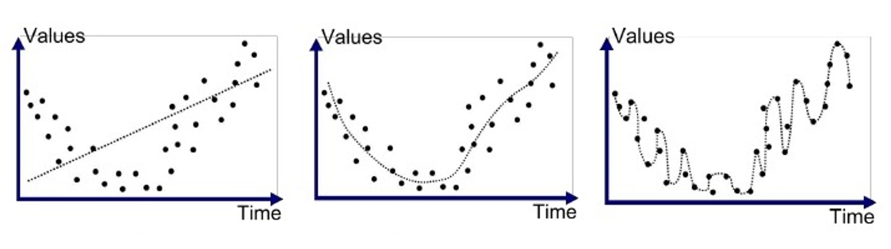
Focused Learning – Advance Regression
In the given diagrams which is Good Fit, Under fit and Over fit?
A
B
C
Notes:
Which diagram is overfit and why?

Slide 6
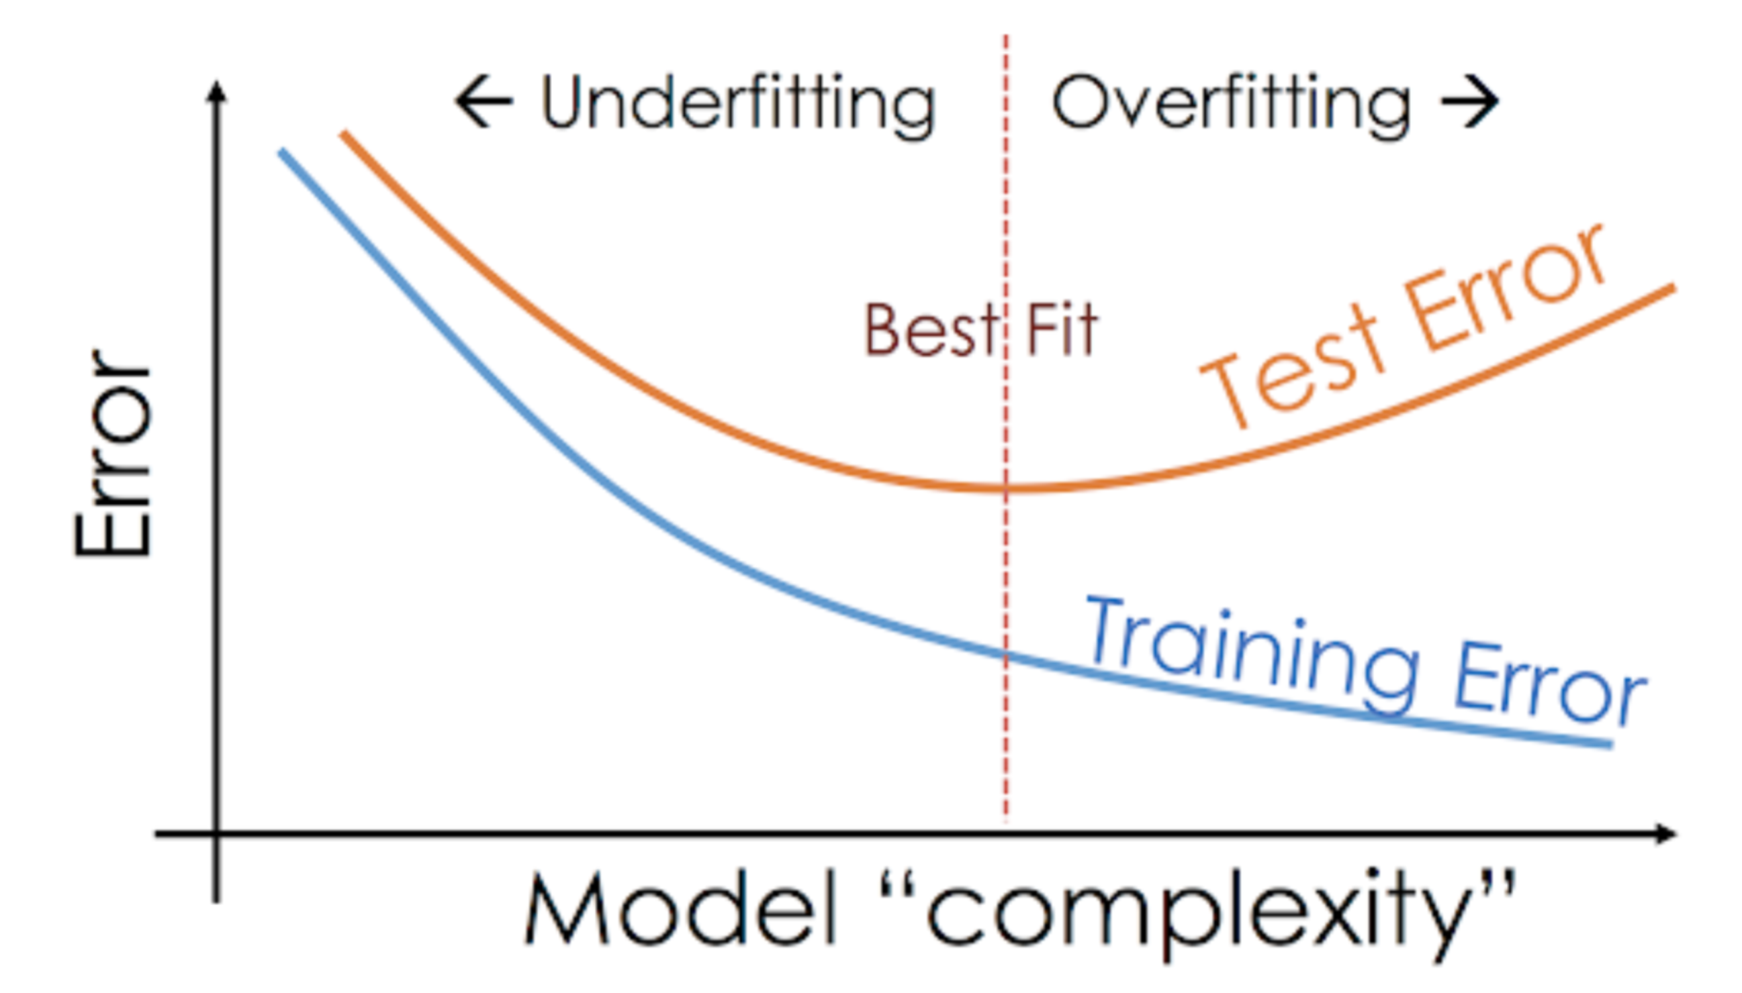
Focused Learning – Advance Regression
What the problem with Overfitting?
So How to overcome it?
Notes:
With increase of model complexity test error increase

Slide 7
Focused Learning – Advance Regression
Why don’t we punish any model who start becoming more complex.
We will add penalty if model try to become complex.
Cost Function
Control
Penalty
Notes:
Start with theme of how to show accountability and take initiatives and accepting your mistakes to take corrective actions

Slide 8
Focused Learning – Advance Regression
Regression
Linear
Lasso (L1)
Elastic Net
Ridge (L2)
Notes:
Types of Regression

Slide 9

Focused Learning – Advance Regression
Ridge Regression(L2 Regularization)
$$+ λ\sum_{j}^{N}{w_{j}^{2}}$$
L2 is equal to sum of square of magnitude of coefficients.
If λ is Zero this will be Simple linear regression.
With proper penalty we can leads to lower variance which gives lower error value.
Ridge regression decreases the complexity but does not reduce the number of variables.
Notes:
Start with theme of how to show accountability and take initiatives and accepting your mistakes to take corrective actions

Slide 10

Focused Learning – Advance Regression
Lasso Regression(L1 regularization)
$$+ λ\sum_{j}^{N}{{\left|W\right|}_{j}^{}}$$
Similar to ridge the penalty is control by λ.
Its sum of absolute value of the magnitude of the coefficients
for large lambda value some features shrunk to zero
L1 regularization allows for feature selection.
Notes:
Start with theme of how to show accountability and take initiatives and accepting your mistakes to take corrective actions

Slide 11
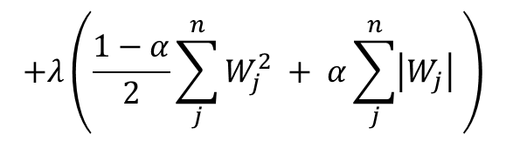
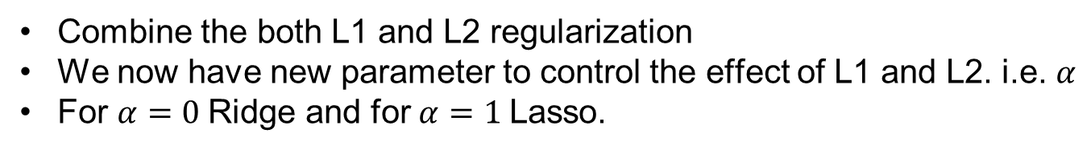
Focused Learning – Advance Regression
Elastic Net
$$+λ\left(\frac{1−α}{2}\sum_{j}^{n}{W_{j}^{2}} + α\sum_{j}^{n}{\left|W_{j}\right|} \right)$$
Combine the both L1 and L2 regularization
We now have new parameter to control the effect of L1 and L2. i.e. $α$
For $α=0$Ridge and for $α=1$Lasso.
Notes:
Start with theme of how to show accountability and take initiatives and accepting your mistakes to take corrective actions

Slide 12
Focused Learning – Feature Selection
Feature Estimation: Finds a set of new features (i.e., through some mapping f()) from the existing features
Feature Selection: Chooses a subset of the original features

Slide 13
Focused Learning – Feature Selection
Feature Selection techniques
Feature Selection
Unsupervised
Supervised
Intrinsic
Wrapper
Filter
Trees
RFE
Stats
Feature importance
Correlation
Notes:
Feature Selection: Select a subset of input features from the dataset.
Unsupervised: Do not use the target variable (e.g. remove redundant variables).
Correlation
Supervised: Use the target variable (e.g. remove irrelevant variables).
Wrapper: Search for well-performing subsets of features.
RFE
Filter: Select subsets of features based on their relationship with the target.
Statistical Methods
Feature Importance Methods
Intrinsic: Algorithms that perform automatic feature selection during training.
Decision Trees

Slide 14
Focus teaching – feature Selection
Recursive Feature Elimination
N-fold CV for every subset
Features
Generate subset
Feature subset
ML Model
ML model
CV
Performance
Feature Ranking
Feature subset & Performance
Sub selected Features

Slide 15
Coding Time
Coding Time
Notes:
Coding time

Slide 16
Quiz Time
Quiz Time
Notes:
Quiz time
https://forms.gle/jGuE5vVzQibyKv51A

Slide 17

Doubts Resolutions

